Slide 1
SPARROW
Sensor Package for Advanced Reconnaissance and Robust Operational Workflows
Sponsored by Lockheed Martin

Slide 2





Meet The Team
Isaiah McCarty
Electrical Engineering
Max Hoffner
Electrical Engineering
Jack Gao
Computer Engineering
Patrick Rizkalla
Computer Engineering
Esteban Venegas
Computer Engineering

Slide 3
Motivation and Background
Search and rescue operations have long been a critical response to many emergency situations. Traditionally carried out by human teams, these operations have seen significant advancements with the integration of drone technology.
Why Drones? - Drones offer a distinct advantage for search and rescue applications, as they are capable of providing an aerial perspective that enhances situational awareness as well as facilitates more effective search for individuals in need.
To address the challenges of traditional methods and to improve the safety and efficiency of these operations, SPARROW presents an innovative solution that establishes communication between drones and a base station controller, enabling drones to scan affected areas and transmit real-time data back to the base station.
Notes:
End of Slide: Note that SOAR is part of the drones while SPARROW is mostly the base station

Slide 4
Goals
Develop a drone base station that is capable of managing communication with the drone sensor package.
Reliably send and receive data between drone and base station
Detect humans via computer vision on the sensor package and alert through communication to the base station
Provide feedback from the cameras on the drone and show the footage on the ground station’s display
Provide GPS location of base stations to mark communication starting point
Stretch Goals:
Implement a user interface on the base station display for ease of operation through a touchscreen display
Incorporating a base station where it would allow drones to come down and recharge its battery

Slide 5
Objectives
Data Transmission: Seamlessly transmit data and commands to the drone for effective deployment and operation.
Data Reception: Receive real-time data from the drone, including their status and conditions.
Automatic Search and Rescue Detection: Utilize advanced computer vision technology to automatically detect individuals in need of assistance without requiring direct human intervention.
Image Display: Utilize communication protocol to send image data over the network to show the detected humans
Notes:
Here are the Objectives for SPARROW, the base station would involve data transmission and reception between itself and the drones. The drones would utilize computer vision to detect individuals in need of assistance without the need of human actions. The communication protocol would send the image data over the network to show detected humans.

Slide 6
Engineering Requirements
Engineering Requirement | Specification
Communication Range | ≤ 10 meters
Human Detection Accuracy | ≥ 60%
Maximum Latency | 100 ms
Human Detection Range | ≥ 20 meters
Weight of Base Station | ≤ 2 kilograms
System Battery Life | > 1 hour
Notes:
These are the key engineering requirements that guided the design of our system.
Starting with communication range, we aimed for at least 10 meters to ensure reliable data transmission between the drone and the ground station.
Our human detection accuracy target was set at over 60%, which we were able to approach during testing with a model that achieved an average precision of 58%.
Startup time had to be fast — under a minute and a half — to make the system responsive in urgent situations.
We also needed the system to detect people from at least 20 meters away, which informed our choice of camera resolution and model tuning.
Display response time had to stay under 5 milliseconds to avoid lag when switching between RGB and thermal views.
The entire base station was required to weigh under 2 kilograms for easy deployment in the field.
Lastly, the system battery needed to last more than an hour — enough time for a drone search sweep in a moderately sized area.

Slide 7
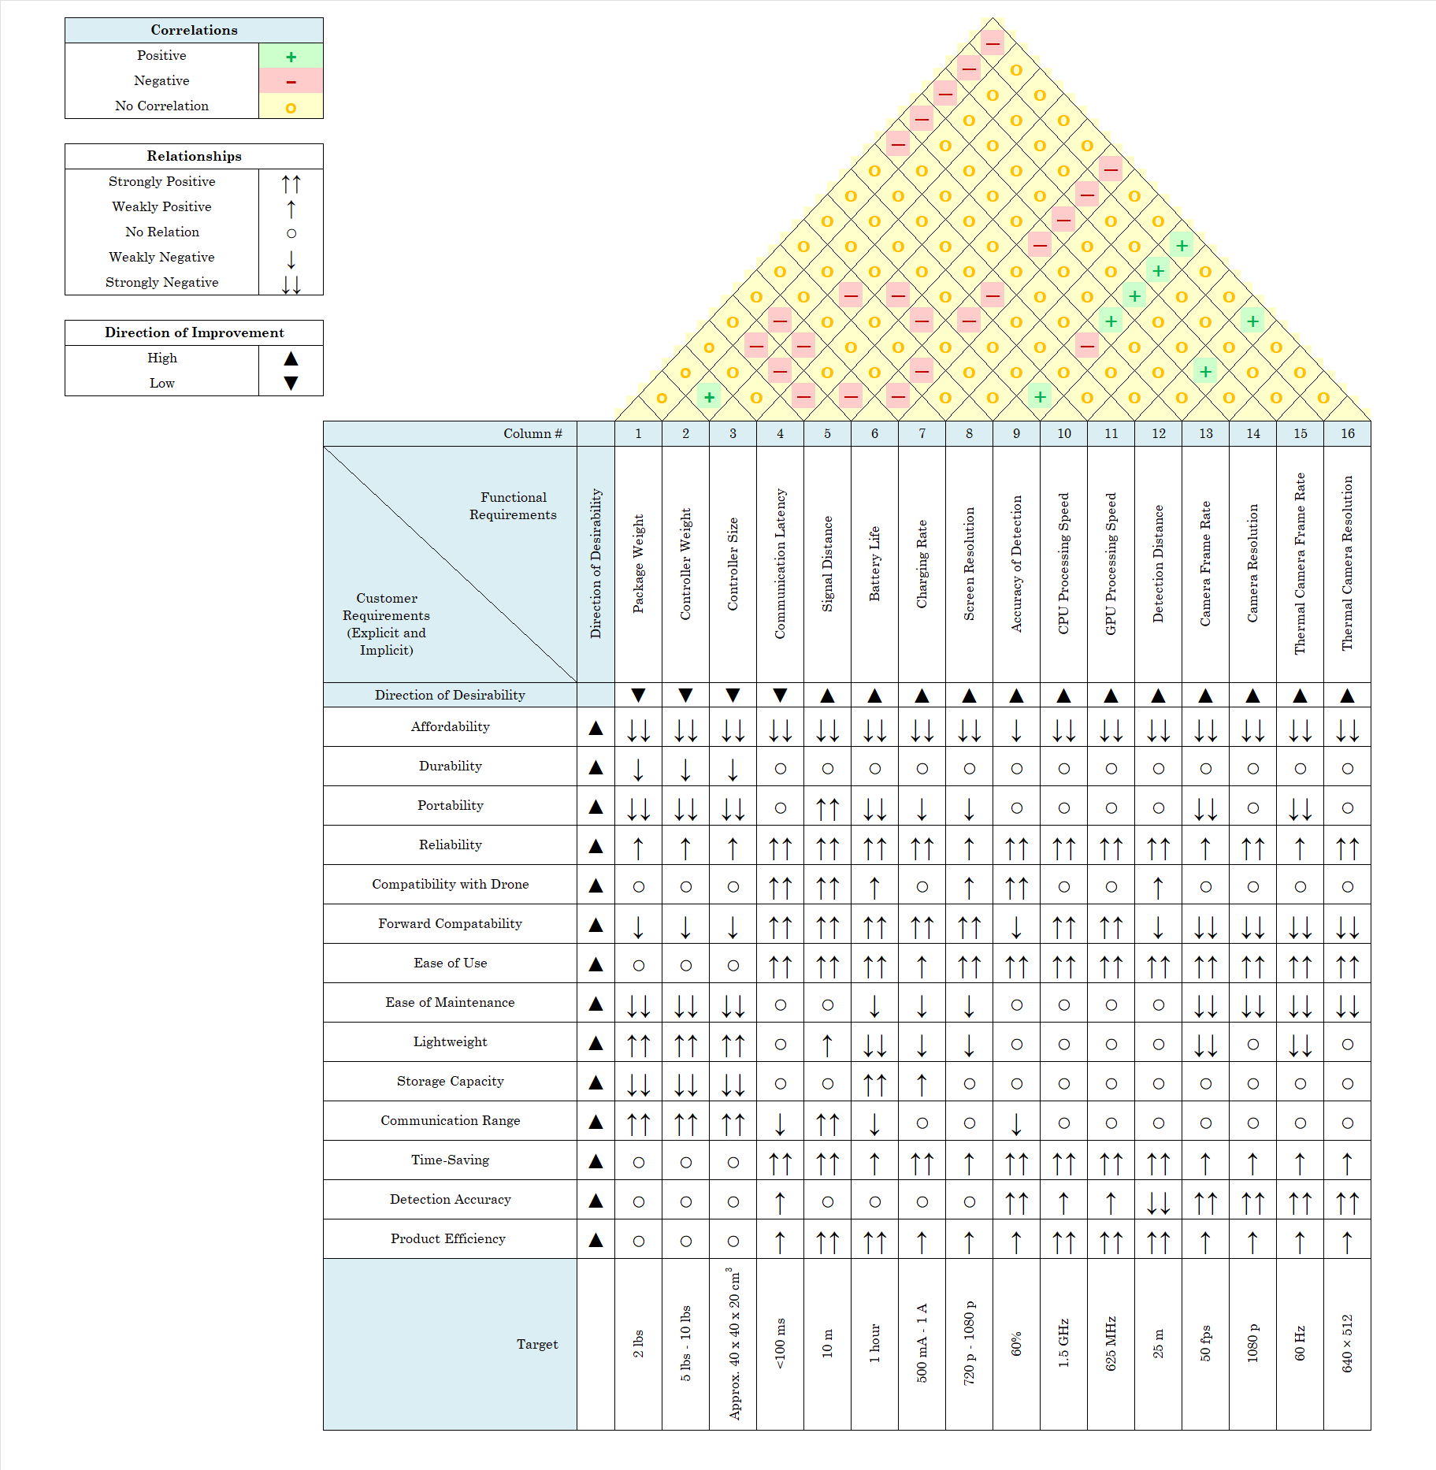
House of Quality
Notes:
We based many of our decisions using the House of Quality. By analyzing the relationships between various customer demands and technical features, we were able to identify which specifications held the most importance and should receive the greatest focus during development. This structured approach helped ensure that our design choices aligned closely with user expectations and project goals.

Slide 8
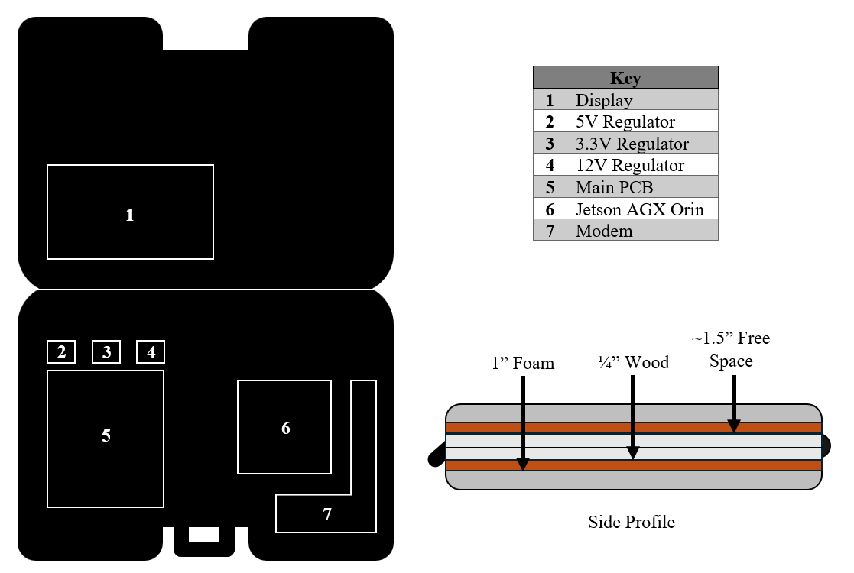
Enclosure Conceptualization
Notes:
We decided to store the base station in a suitcase-like enclosure that will allow the user to move the station easily. Both halves of the enclosure will have 1” of foam padding and a ¼” wood panel which the boards and display will be mounted to.

Slide 9
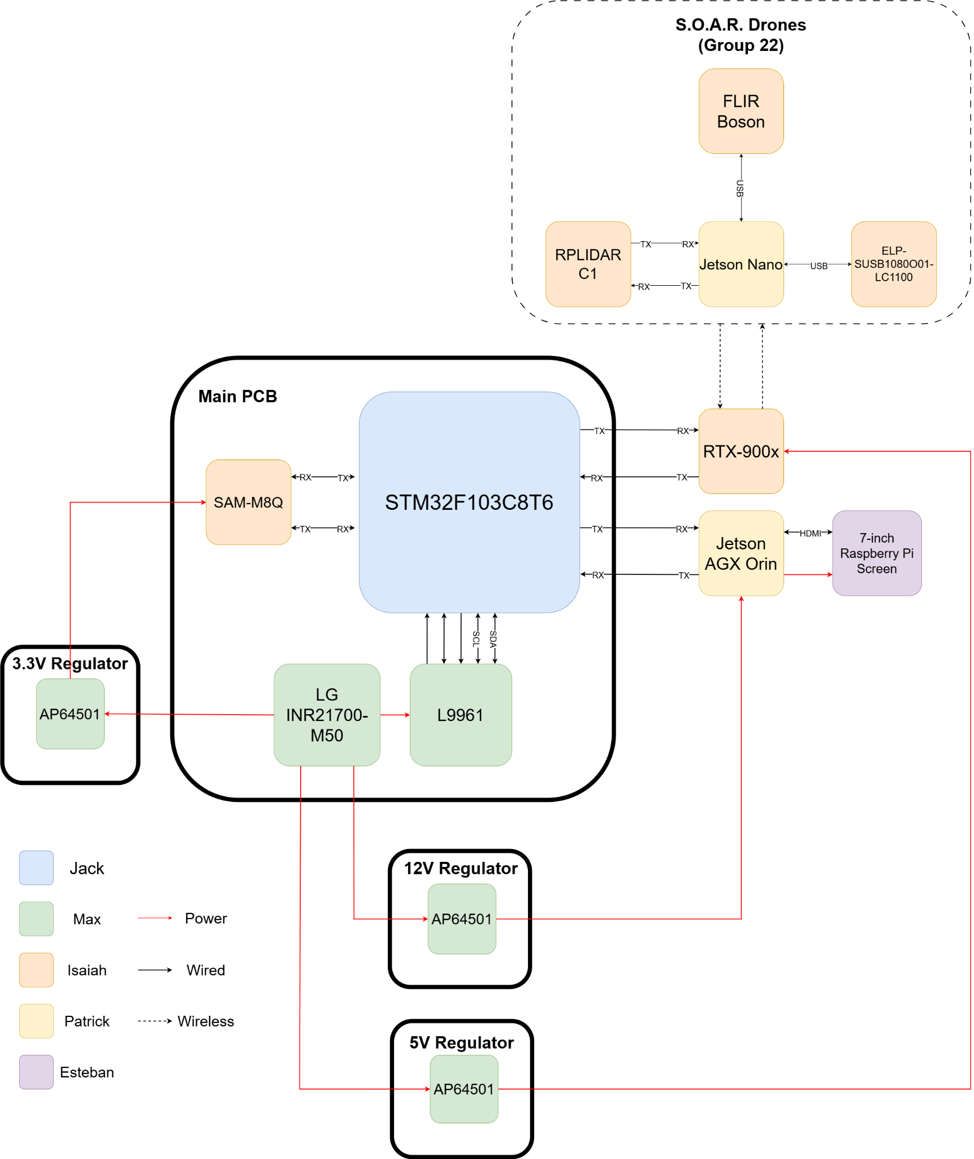
Hardware Diagram
This hardware diagram for SPARROW showcases our core components and power distribution system.
At the heart of the system is our custom main PCB, which integrates our batteries, battery management system, GPS module, and microcontroller.
To meet various voltage requirements, we use three dedicated voltage regulators: 3.3V, 5V, and 12V, each placed on separate boards.
The main PCB also includes connectors for external components such as our radio modem, Jetson Orin Developer Kit, ensuring both power delivery and peripheral communication.
Our radio modem plays a crucial role in transmitting and receiving signals to and from sensors that will be mounted on Group 22’s SOAR drones.
Notes:
This slide showcases the low-level hardware diagram for SPARROW. As you can see, our main PCB consists of the batteries, our battery management system, our GPS module, and our microcontroller.
We have three regulators: a 3.3V, a 5V, and a 12V regulator, each of which are placed on separate boards.
All of our external components like our radio modem and the Jetson Orin Dev Kit have connectors on our main PCB so that we can supply power to them and allow them to communicate with our peripherals.
Our modem is used to transmit and receive signals to and from our sensors which will be implemented onto group 22’s SOAR drones.

Slide 10
Thermal Camera Part Selection
Despite the high cost of the FLIR Boson, the higher resolution and frames of the FLIR Boson camera provides is unmatched with the other cameras are superior. Since it is provided by Lockheed Martin, price is not a concern.
 | AMG8833 | MLX90640 | MLX90641 | Boson LWIR OEM Module 320
Resolution | 8x8 pixels | 32x24 pixels | 16x12 pixels | 320x256 pixels or 640x512 pixels
FPS | 10 | 0.5 - 32 (Programmable) | 0.5 - 32 (Programmable) | 60 Hz, 30 Hz, or 9 Hz
Range of Thermal Detection | 0°C to 80°C | -40°C to 300°C | -40°C to 300°C | Up to 140 °C or Up to 500 °C
Field of View | 45°x 45° | 55°x 35° or 110°x 70° | 55°x 35° or 110°x 70° | 92°x 74°
Current Consumption | 4.5 mA | 23 mA | 12 mA | 152 mA
Cost | $44.95 | $54.99 | $44.99 | $1,959.00
Notes:
When it came to choosing the thermal camera for SPARROW, the FLIR Boson stood out as the top option, despite the high cost, which our sponsor Lockheed Martin generously offered to cover. The performance the Boson offers is unmatched when compared to other products we considered. Even with the resolution of just 320x256 pixels, it provides 100 times the pixel count of the second best option. This higher resolution allows for much more detailed thermal detection, which is crucial for search and rescue operations.
While the Boson has the highest power consumption, its higher resolution and wide temperature detection range justify this trade-off. This higher resolution ensures that we can capture the best possible details of the environment.
Its superior resolution, frame rate, and thermal detection capabilities make it an invaluable asset for search and rescue operations. Thanks to our sponsor for covering the cost, we can afford this high-performance camera without worrying about the price, which made it a clear winner.

Slide 11
Regular Camera Technology Selection
 | Ethernet | USB | Coaxial Cables
Reliability | Moderate | Low | High
Ease of Use | Moderate | High | Low
Resolution | High | Moderate | Low
FPS | High | High | Low
Camera Range | Very Low | Moderate | High
Field of View | Moderate | Moderate | Low
Power Consumption | Moderate | Low | Moderate
Size/Weight | Moderate | Low | High
Cost | Moderate | Low | Moderate
We chose a USB camera for its ease of use, affordability, reasonable performance, and high frame rates, making it a practical and reliable option, although there are minor reliability concerns.
Notes:
When deciding what type of digital camera to use, we have decided that a USB camera is the best option for our purposes. These cameras offer excellent ease of use and provide reasonable video resolution, power consumption, range, and size. Their affordability also allows us to keep replacement cameras on hand, which is an important consideration.
Additionally, the higher frame rates are valuable, as a reliable video feed from the camera is essential for SPARROW. While there may be some concerns regarding their reliability, the low cost makes it possible to replace them if necessary. For these reasons, we chose to move forward with a USB camera.

Slide 12
USB Camera Selection
We chose the ELP camera for its optimal balance of resolution, frame rate, power consumption, and cost, with the Arducam rejected due to risks with its manual focus and the GXIVision dismissed for its high cost and uncommon aspect ratio.
 | GXIVision | ELP-SUSB1080P01-LC1100 | Arducam
Maximum Resolution | 1600x1200 | 1080p | 3840x2160
Maximum Aspect Ratio | 4:3 | 16:9 | 16:9
Focus Type | Fixed | Fixed | Manual
Maximum FPS | 60 | 50 | 30
Horizontal Field of View | 179.6° | 70° | 110°
Maximum Operating Current | 200 mA | 220 mA | 300 mA
Size | 38 x 38 x 16 mm | 38 x 38 mm | 38 x 38 x 16 mm
Cost | $68.88 | $60.90 | $59.99
Notes:
After evaluating all three USB camera options, we determined that the ELP camera best meets SPARROW’s needs. It has the best balance between resolution, frame rate, power consumption, and cost. The camera’s lower field of view is manageable due to the drone’s mobility.
Although the Arducam offered more features at a similar price, the risk associated with its manual focus feature outweighed its benefits. On the other hand, the GXIVision camera, despite its superior performance in several areas, was ultimately considered to be too expensive and had a less common aspect ratio.

Slide 13
GPS Module Selection
The SAM-M8Q GPS Module was chosen for its good accuracy, support for I2C or UART protocols, and built-in antenna, offering sufficient performance for our needs despite not being the best or cheapest option.
 | PA1616S | NEO-M9N | ZED-F9R | SAM-M8Q
Accuracy | 3 meters | 2 meters | 0.01 meters | 2.5 meters
Interfaces | I2C, UART | I2C, SPI, UART, USB | I2C, SPI, UART, USB | I2C, UART
Built-In Antenna | No | No | No | Yes
Average Power Consumption | ~66 mW | ~84 mW | ~210 mW | ~69 mW
Operating Voltage | 3.0 V - 4.3 V | 2.7 V - 3.6 V | 2.7 V - 3.6 V | 3.3 V - 5 V
Cost | $24.95 | $27.00 | $149.00 | $31.50
Notes:
The SAM-M8Q GPS Module stands as the best choice for our project due to its fairly high accuracy, its choice between using I2C or UART protocols, and its built-in antenna. Although it may not offer the best performance or be the cheapest option, it is perfectly adequate for our purposes.

Slide 14
Display Parts Selection
 | HMTECH 7” | FayTech 12.5” | 15.6 IPS | 75Hz Monitor | 7” Raspberry Pi screen
Size | Compact | Larger | Too Big | Desktop use | Compact
Power Usage | Low | Higher | Higher | Higher | Low
Viewing Angles | Wide | Wide | Wide | WIde | Wide
Cost | Budget-friendly | Expensive | Expensive | Expensive | Budget-friendly
Readability | Good | Good | Good | Good | Good
Integration | Plug-and-play | More Complex | More Complex | More Complex | Plug-and-play
We chose the 7 inch Raspberry Pi screen for its touchscreen capability and its plug and play
Notes:
This chart shows our comparison of potential display options for the ground station.
We prioritized screens that were compact, low-power, easy to integrate, and budget-friendly — while still providing good readability and wide viewing angles.
Larger options like the FayTech and 16.5-inch IPS monitor offered more screen space but were either too bulky or drew more power than we wanted for a field-ready system.
The 75Hz monitor was a great desktop choice but not practical for portability.
We ultimately chose the 7-inch Raspberry Pi screen — it’s compact, low-power, touchscreen capability, has good readability and is plug-and-play, which made integration seamless.
Overall, it offered the best balance of portability, simplicity, and performance for our use case.

Slide 15
Radio Modem Selection
We selected the RFD900x-US modem for its superior range of, ease of use, and MAVLink compatibility with Ardupilot, which simplifies setup. Despite being more expensive than alternatives, its value in range, reliability, and included components makes it a cost-effective and high-performance choice.
 | RFD900X-US | P900 | P900-ENC
Frequency Band | 900 MHz | 900 MHz | 900 MHz
MavLink Support | Yes | Yes | Yes
Range | <40 km | <65 km | <65 km
Data Rate | <500 kbps | <276 kbps | <276 kbps
Transmit Power | 1 W | 100 mW - 1 W | 100 mW - 1 W
Power Consumption | <4.4 W | 9.8 W - 49 W | 9.8 W - 49 W
Cost | $226 | $199 | $215
Notes:
For our radio modem selection, we chose the RFD900x-US due to its superior range and ease of use. With an impressive range of up to 40 km, it ensures reliable communication over long distances, a key requirement for SPARROW.
Much like the alternatives, the RFD900x supports MAVLink and is compatible with Ardupilot, which simplifies the setup process for SPARROW.
Although the RFD900x is more expensive than the Microhard P900 and P900-ENC, the value it offers in range, reliability, and ease of integration justifies the investment. Additionally, the RFD-900x-US Bundle includes all necessary components, including the 900 MHz antennas, eliminating the need for any additional purchases. This cost-effective solution combined with its high performance is why we chose this option.

Slide 16
Processor Part Selection
Criteria/MCU | ESP32-WROOM-32 | STM32F103C8T6 | Teensy 4.1 | Jetson Nano | Jetson AGX Orin
Clock Speed | Up to 240 MHz | Up to 72 MHz | Up to 600 MHz | Up to 1.43 GHz | Up to 2.2 GHz
RAM | 520 KB | 20 KB | 512 KB | 4 GB | 32 GB
Flash Memory | 4 MB | 64 KB | 8 MB | None (Requires External) | 64 GB
Power Consumption | Low | Low | Low-Moderate | Moderate-High | Moderate-High
The STM32F103C8T6 Microcontroller will serve as the PCB’s functionality to forward battery data and gps data of the base station to the Jetson Orin.
The Jetson AGX Orin will serve as the main of the ground station to display everything from image received to mission planner data.
The Jetson Nano on the drone will route flight controller data alongside its own image data after it does the human detection.
Notes:
Jack

Slide 17
BMS Part Selection
Criteria | BQ76925 | BQ76920 | AD7280WBSTZ-RL | L9961
Input Voltage (V) | 4.2 - 26.4 | 4.2 - 26.4 | 4.5 - 18 | 4.3 - 25
Communication Interface | I2C | I2C | SPI | I2C
Voltage Sensing | Yes | Yes | Yes | Yes
Current Sensing | Yes | Yes | Yes | Yes
Cell Balancing | Yes | Yes | No | Yes
Overvoltage Protection | Yes | Yes | Yes | Yes
Undervoltage Protection | Yes | Yes | Yes | Yes
Short-Circuit Protection | Yes | Yes | Yes | Yes
Internal Voltage Reference | Yes | Yes | No | Yes
Price | $0.86 | $1.46 | $15.37 | $2.41
We chose the L9961 because it was specifically designed by STMicroelectronics to interface with the STM32, allowing for simple and seamless integration.
Notes:
Due to the demanding power requirements, a multicell array of batteries is used.
To monitor, manage, and safely protect the other components from these batteries, an advanced BMS will be utilized.
We selected the L9961 because it was designed by STMicroelectronics to interface with the STM32, allowing for simple and seamless integration.
Furthermore, it is capable of managing the high current output of the five cell battery array with little power loss.

Slide 18
Power Tree
Hardware Component | Supply Voltage | Maximum Current Draw | Maximum Power
Jetson AGX Orin Dev Kit | 10 V - 20 V | 3 A | 60 W
HMTECH 7-inch Raspberry Pi Screen | 5 V | 2 A | 10 W
STM32F130C8T6 | 2 V - 3.6 V | 150 mA | 540 mW
RFD900x-US | 5 V - 5.5 V | 60 mA | 300 mW
SAM-M8Q-0-10 | 2.7 V - 3.6 V | 10 mA | 36 mW
L9961 | 4.3 V - 25 V | 5 µA | 125 µW
Notes:
To supply stable voltage to all of our components, three power rails are required, this includes:
A 12V rail that is used to power the Jetson AGX Orin developer kit.
A 5V rail that is used to power the modem.
And a 3.3V rail that is used to power the GPS
The STM32 will use the low current 3.3V voltage supply provided by the L9961

Slide 19
Battery Comparison
Criteria | Sony VTC6 | Samsung INR18650-30Q | LG MJ1 | Samsung INR21700-40T | LG INR21700-M50
Nominal Cell Voltage (V) | 3.6 | 3.6 | 3.6 | 3.6 | 3.6
Energy Density (Wh/kg) | 270.4 | 262.5 | 300.0 | 251.5 | 303.2
Rating | 4.2 V 3 Ah | 4.2 V 3 Ah | 4.2 V 3.5 Ah | 4.2 V 4 Ah | 4.2 V 5 Ah
Weight (g/per cell) | 46.6 | 48 | 49 | 66.8 | 69.25
Dimensions (mm) | 18.5 x 65.2 | 18.3 x 64.9 | 18.3 x 65.1 | 21.1 x 70.4 | 21.0 x 70.4
Cost (per cell) | $6.00 | $5.99 | $5.99 | $5.99 | $4.99
We chose five LG INR21700-M50 5Ah batteries for their high energy density and the low cost when compared to all of the options we evaluated. Their balance of performance and affordability made them the most efficient choice for our design.
Notes:
As mentioned previously, due to the demanding power requirements, a multicell array of batteries is required.
We decided to use five LG INR21700-M50 5Ah batteries because they offered the most energy density while being the cheapest option we evaluated.
They will provided a total of 105 Wh of power, which is enough to power the system for 1:30.
The full battery lifetime of SOAR totals 15 minutes, meaning SPARROW has more than enough power to last several missions before needing a recharge.

Slide 20
Voltage Regulator Selection
Criteria | AP64501 | TPS566247DRLR | LM2596
Input Voltage (V) | 3.8 - 40 | 3 - 16 | 4.5 - 40
Output Voltage (V) | 0.8 - 39 | 0.6 - 7 | 3.3, 5, 12
Maximum Output Current (A) | 5 | 6 | 3
Price | $3.22 | $0.57 | $8.63
We chose to use the AP6501 because it offered a wide input and output voltage range, allowing us to use it for all three voltage rails
Notes:
We decided to use the AP64501 for all three of the power rails.
This is because the AP64501 is able to support the five cell battery array which outputs a voltage range between 12.5V and 21V at a maximum of 10A.
Furthermore, the AP64501 has configurations for all the power rails we require.
And while the LM2596 meets these same specifications, it costs over double the price of the AP64501, making the it the obvious choice.

Slide 21
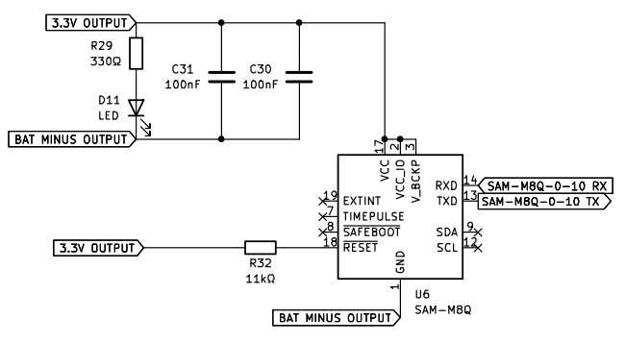
Electrical Design - GPS (SAM-M8Q)
Communication with STM32::
UART:
RX: GPS Pin 14 → TX: STM Pin 22.
TX: GPS Pin 13 → RX: STM Pin 21.
Reset Configuration:.
Reset pin pulled up to 3.3V (active low).
Power Indicator:
LED connected to 3.3V rail for visual confirmation of power and functionality.
Notes:
The SAM-M8Q GPS module is integrated onto our main board, which simplifies its connection to the PCB by requiring minimal external circuitry.
For communication, the GPS module will interface with the STM32 through UART. Pin 14 on the GPS connects to pin 22 on the STM32, and pin 13 on the GPS will connect to pin 21 on the STM32. Since I2C communication is not used, the SDA and SCL pins are left unconnected.
Additionally, an LED is connected to the 3.3V power supply rail as a clear visual indication that the GPS is powered on and should be functioning correctly.

Slide 22
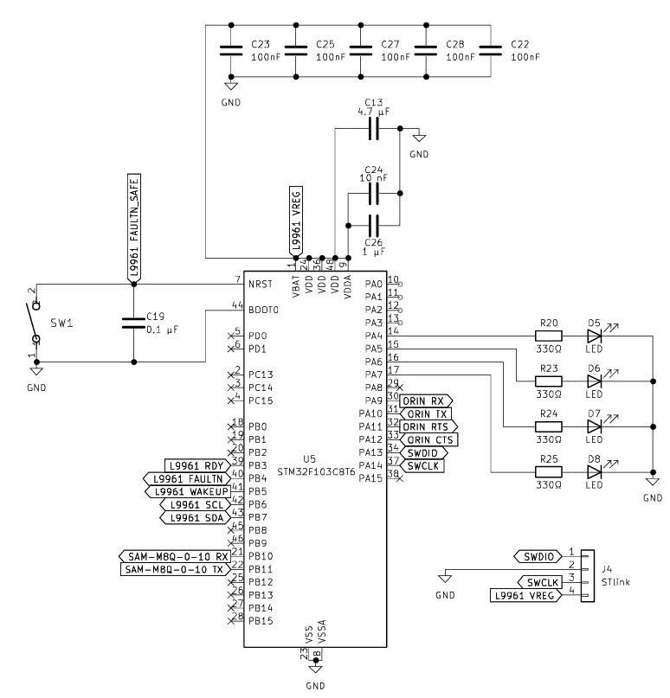
Electrical Design - Microcontroller (STM32F103C8T6)
Communication with BMS:
I2C interface:
SCL: STM pin 42 → BMS pin 5
SDA: STM pin 43 → BMS pin 6
Communication with GPS:
UART interface:
RX: GPS Pin 14 → TX: STM Pin 22.
TX: GPS Pin 13 → RX: STM Pin 21.
Communication with Orin:
UART interface
RX: STM pin 31 → TX: Orin pin 8
TX: STM pin 30 → RX: Orin pin 10
Diagnostic LEDs connected to pins 14 - 17
Notes:
The STM32F103C8T6 microcontroller is used to drive the PSU in our system, managing its operation and communication with peripheral devices. To provide a clear visual indication that our MCU is powered on, an LED is connected to its 3.3V supply.
To communicate with our Battery Management System, an L9961, we utilize I2C to exchange battery-related data to the MCU. In addition to I2C communication, the BMS uses three dedicated GPIO pins to relay critical battery status information, such as charge levels, temperature, and fault conditions, directly to the STM32. These connections provide direct monitoring, enhancing the safety and reliability of our system.

Slide 23
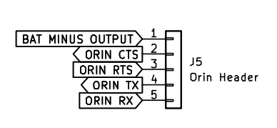
Electrical Design - Jetson AGX Orin Developer Kit
To meet significant PCB requirements, our other peripherals (BMS, GPS) communicate directly with the STM32.
Information is then relayed from the STM32 to the Orin through UART.
Notes:
The Jetson Orin Developer Kit communicates with our STM32 microcontroller through the UART interface, which is facilitated through a USB to UART bridge connected to one of the Orin’s USB-A ports. This setup allows for reliable serial communication between the two devices, essential for tasks such as data transmission. On our PCB, we’ve included dedicated header pins specifically for this connection. Jumper wires run from these header pins to the USB to UART bridge, creating a flexible and easily accessible link between the STM32 and the Jetson Orin.

Slide 24
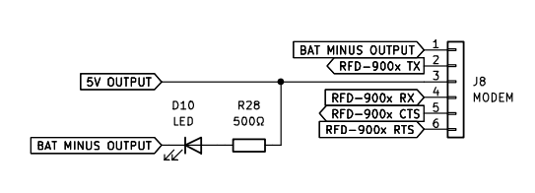
Electrical Design - Modem (RFD-900x)
Pin 1 on the PCB header connects to pin 1 on the modem. Pin 2 on the header connects to pin 3 on the modem, etc.
Communication with Jetson AGX Orin:
UART interface:
Tx: Modem pin 9 → Rx: Orin pin 13
Rx: Modem pin 7 → Tx: STM pin 12
Notes:
To interface with the Jetson Orin, our modem utilizes UART communication, accessed through the Orin’s 40-pin expansion header. These lines are cross-coupled, so the Rx pin of the modem connects to the Tx pin on the Orin, and the Tx pin on the modem connects to the Rx pin on the Orin.
To power the RFD-900x modem, a stable 5V DC supply is required and to monitor the power status, an LED is connected to our 5V supply rail to provide a visual indication as to whether or not the modem is receiving any power.

Slide 25
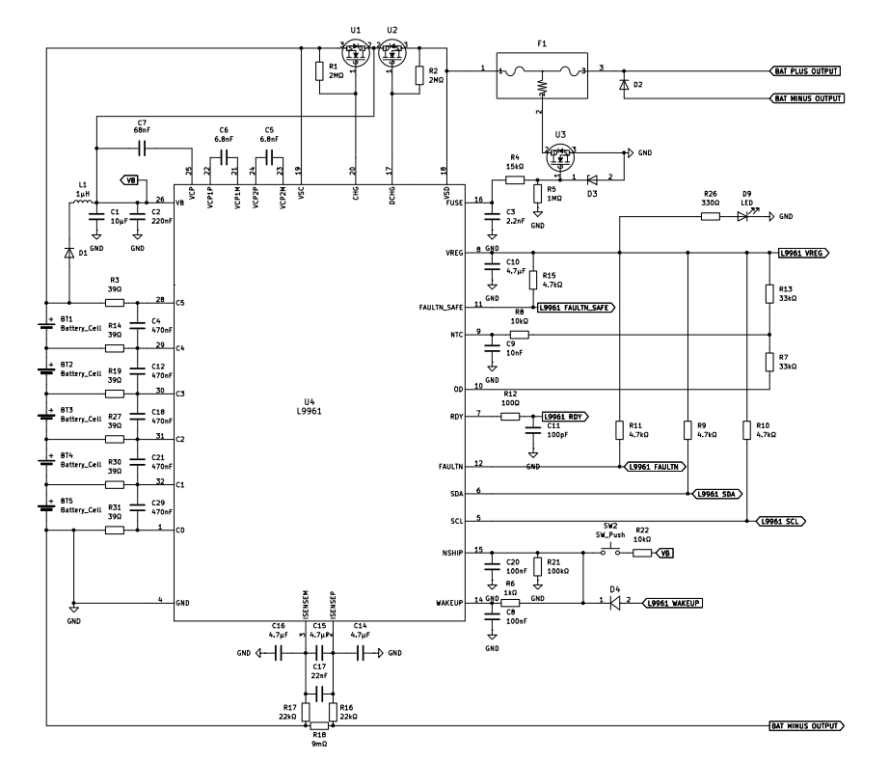
Electrical Design - BMS (L9961)
Notes:
The L9961 IC is used for SPARROW’s base station battery management system as contains software library that enables it to be interfaced with the STM32 MCUs and enables various configurations alongside.
The L9961 provides voltage and current monitoring to ensure appropriate power throughout the entire ground station system.

Slide 26
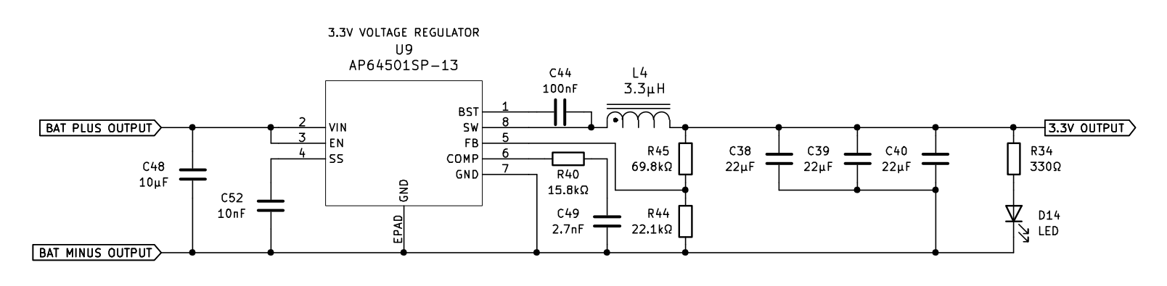
Electrical Design - 3.3V, 5V, & 12V Voltage Regulator (AP6501)
 | 3.3V | 5V | 12V
L | 3.3 µH | 3.6 µH | 10 µH
R | 69.8 kΩ | 115 kΩ | 309 kΩ
L
R
Values from the datasheet were used for L and R
A LED indicator is connected to the output of the voltage regulator, providing a visual confirmation of proper functionality
Notes:
Because the controller requires 3.3 V, 5 V, and 12 V to operate various components and the power supply will produce more than 12 V at its lowest output, a switching voltage regulator (buck) is the ideal choice. Switching regulators offer high efficiency, which is critical given the significant power demands of components like the Jetson AGX Orin

Slide 27
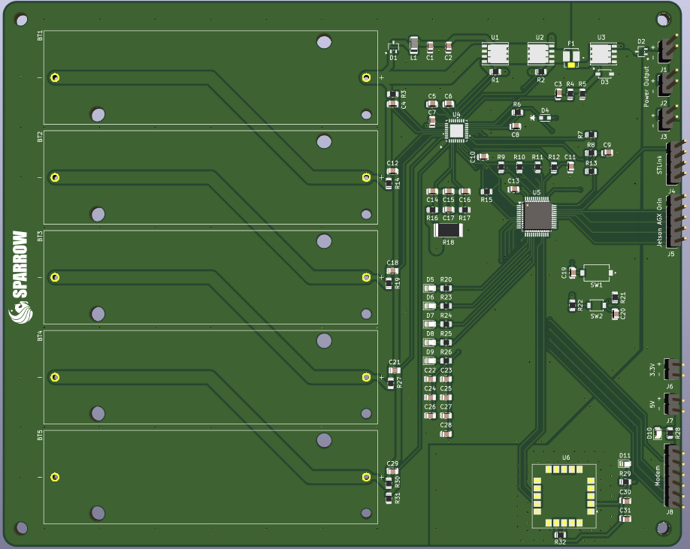
PCB
2 layers are used
Due to course requirements, all peripherals have to interface with the STM32. The STM32 is then interfaced with the Jetson AGX Orin through UART
BMS (L9961)
MCU (STM32F103C8T6)
GPS (SAM-M8Q)
1
2
3
Notes:
We decided to use 2 layers for our PCB, and due to course requirements, all peripherals have to interface with the STM32. The STM32 is then interfaced with the Jetson AGX Orin through UART, we’ve made several changes to the PCB since revision one, such as increasing the copper fill to 2 ounces per foot squared, removing the optocoupler we had between all data traces, switching the GPS to UART instead of I2C, correcting the pinouts of the mosfets U1, U2, and U3 as well as the diodes D1 and D2. We also increased the trace width in several locations and decreased the Orin pin header size.

Slide 28
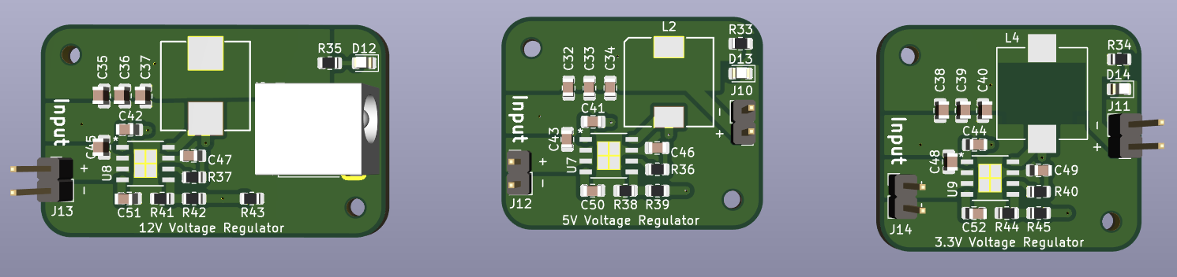
PCB Cont.
3.3V and the 5V voltage regulators will connect directly to and from the main board
The 12V voltage regulator is connected linearly between the main board and the Jetson AGX Orin
The recommended layout for the AP6501 from its datasheet is used

Slide 29
Software Design
The drones would communicate to the base station via MavLink where the radio modem would accept incoming data and be transmitted to the Jetson AGX Orin before processing the data information.
MavLink data would be carefully decoded within the Jetson AGX Orin for correct information before displaying data (images/detection of humans) onto the display on the station.
The STM32 will also forward GPS information and battery of the system from the components connected through UART to the Jetson display.
Communication failures are mitigated by relaying messages through other drones, ensuring uninterrupted operations.
The drone package is equipped with visual and thermal cameras for human detection using YOLO and OpenCV.
Notes:
Jack

Slide 30
Radio Communication Protocol Selection
Criteria | LoRaWAN | APRS | MavLink
Average Range | 5km - 10km | 10km - 30km | <10km
Data Rate | 22 kbps | 1.2 kbps | 9.6 kbps - 57.6 kbps
Operating Frequency | 902.3 – 914.9 MHz | 144.39 MHz | 915 MHz
MAVLink is chosen for the Radio Communication Protocol as it is designed specifically for drone communication and works in conjunction with the RFD900x-us modems that are selected for this project.

Slide 31
MAVLink Communication Design
For the communication protocol, MAVLink is used and transferred between the base station and drone via the RFD900x-us modems.
The message fields of the data allows for a System ID field to identify which device sent that message.
The data fields inside the packets are serialized data that are sent to the modems via a UART connection.
For image transmission protocol via MAVLink, it will first start with a handshake message before proceeding to send all the encapsulated data packets over to the ground station where it would be assembled.
Notes:
Jack

Slide 32
Drone Automation Software Selection
Criteria | ArduPilot | PX4 | DroneKit | Paparazzi UAV | CleanFlight
Development Language | C/C++ | C/C++ | Python, Android | C | C
Mission Planning | Good | Good | Moderate | Good | Bad
Real-time Telemetry | Yes | Yes | Yes | Yes | Yes
Ease of Use | Moderate | Moderate | High | Moderate | High
Sensor Integration | Good | Good | Moderate | Good | Moderate
Autonomous Navigation | Advanced | Advanced | Moderate | Advanced | Basic
Modularity and Customization | High | High | High | High | Moderate
ArduPilot is the clear winner due to its community support across unmanned vehicles, easy integration with Mission Planner for mission planning and designed specifically for MAVLink.
Notes:
ArduPilot for ability to work with MavLink

Slide 33
Detection Algorithm Comparison
Algorithm | Speed | Accuracy | Computational Cost | Best Use Case
YOLO | Fastest | High | Moderate | Real-time detection on low power devices
Faster R-CNN | Slow | Very High | Very High | High-precision object detection
SSD | Faster | Moderate | Moderate-High | Balanced speed and accuracy
EfficientDet | Moderate | High | High | Efficient high-quality detection
CenterNet | Slow | Very HIgh | Very High | Keypoint-based object detection
RetinaNet | Moderate | High | High | Balanced Detection for general application
Notes:
YOLO- Fast, efficient, and optimized for real-time detection
Faster R-CNN (region-based convolutional neural network)- High accuracy but computationally expensive
SSD (Single Shot Multibox Detector)- faster than R_CNN but less accurate than YOLO
EfficientDet- Good balance of accuracy and efficiency but still slower than YOLO for real-time application
CenterNet- High accuracy with keypoint-based object detection but computationally expensive
RetinaNet- Balances speed and accuracy but less optimized for real-time applications
YOLO was chosen for its efficiency on drone hardware with limited computing power, offering an optimal balance between speed and accuracy.

Slide 34
YOLO Versions Comparison
 | Standard Versions | Nano Version
YOLOv5 | 4-6 FPS | 10-15 FPS
YOLOv6 | 3-5 FPS | 15-20 FPS
YOLOv8 | 4-6 FPS | 8-12 FPS
YOLOv10 | 6-10 FPS | 18-22 FPS
Notes:
Patrick
Running on Jetson Nano
Low Core GPU
Limited Input Resolution
Since YOLO will be running on the Jetson Nano, which has a low-power GPU, the input resolution, efficiency, and detection speed are restricted. To maximize the number of frames processed per second while operating within the Jetson Nano's power limitations, we carefully selected the most suitable YOLO model.
We tested four different YOLO models, evaluating both their standard versions and their nano-optimized counterparts, which are designed for low-power GPUs like the Jetson Nano. Using video frames with a base input resolution of 640×640, we measured the output frame rate. The nano version of Model 10 achieved the highest frame rate, making it the optimal choice for our application.

Slide 35
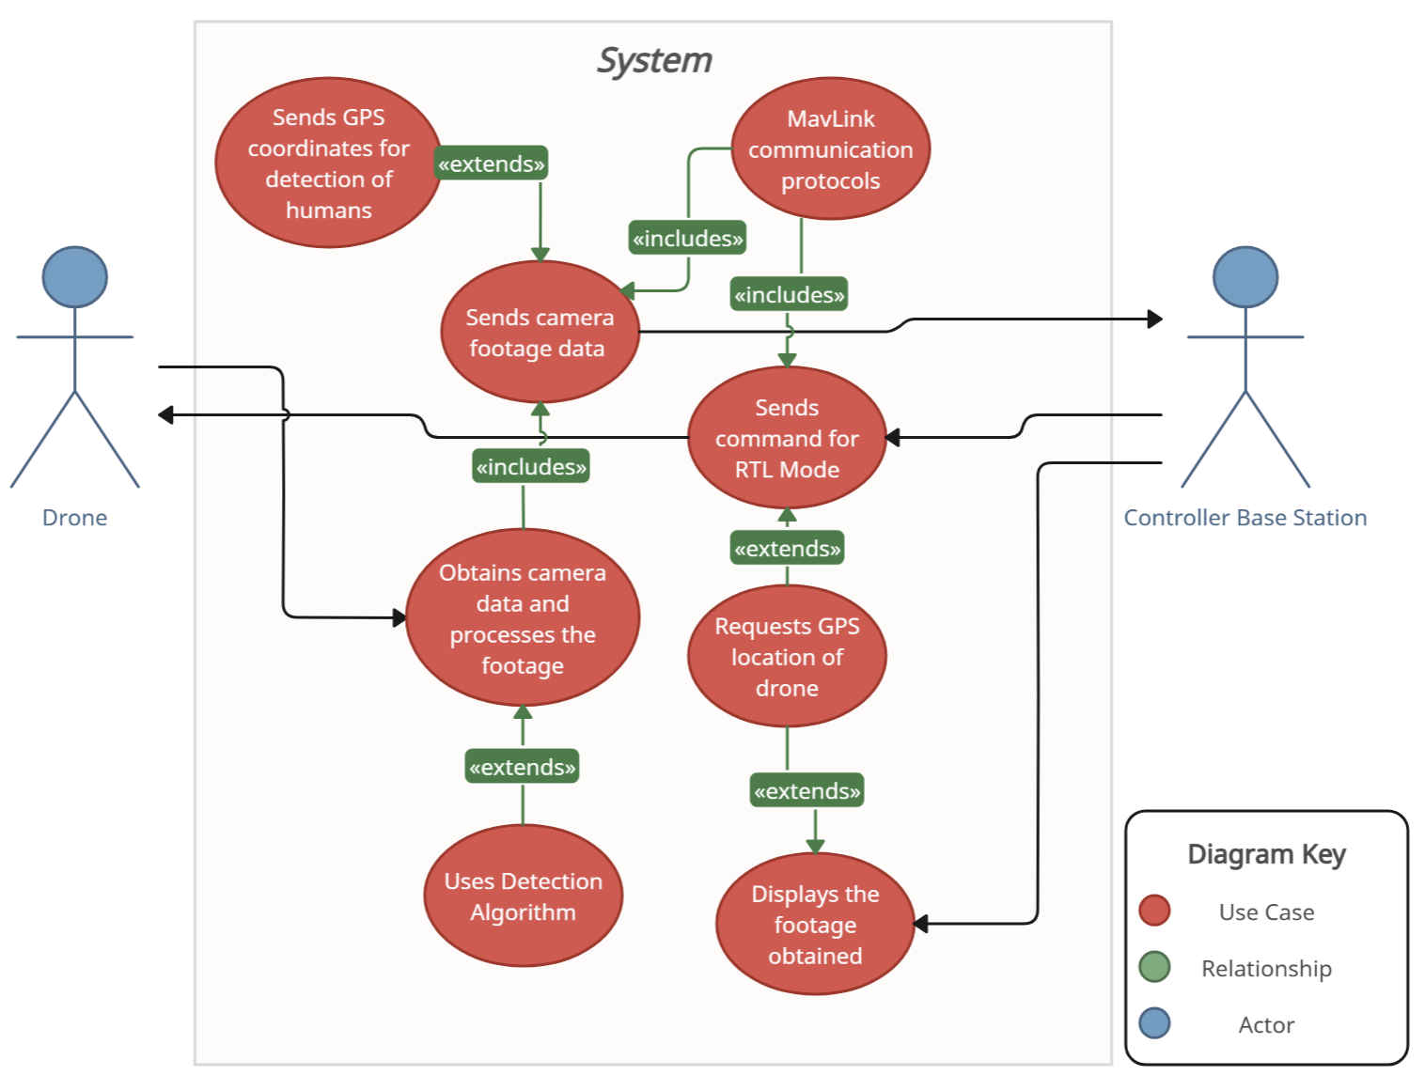
Software Use Case Diagram

Slide 36
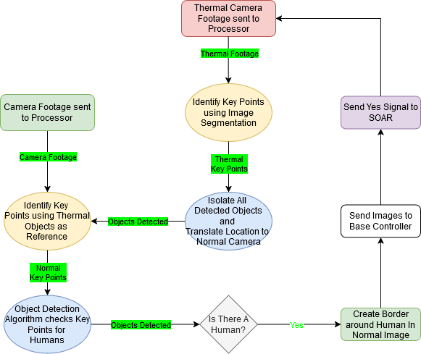
Software Design - Computer Vision
Notes:
Drone captures video using camera and sends footage to the onboard processor for analysis
Image segmentation is applied to detect key features
Object detection scans images for human presence
Once human is detected a bounding box is drawn
Detected images are transmitted to the base controller for verification
This diagram represents our Computer Vision System for human detection running on the Jetson Nano. The process begins by receiving frames from the thermal camera, where all objects on screen are identified based on their heat signatures. The detected objects are then mapped relative to the RGB camera, and each object is cropped into a separate key point or image. This approach allows us to process each image individually at a smaller resolution, optimizing the input for the YOLO model and significantly improving detection speed. Each cropped image is analyzed, and if a human is detected in any of them, a bounding box is placed on the corresponding location in the original RGB image. The annotated image is then transmitted wirelessly to the base controller. Additionally, a signal is sent to SOAR to notify them of the human detection.

Slide 37
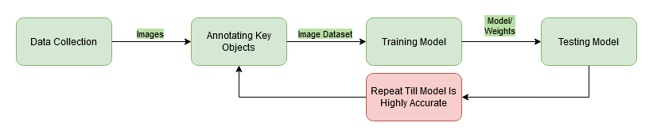
Software Design - Model Training
Gather aerial images will come from footage taken by the drone.
Bounding boxes around humans will be annotated using Roboflow or Labellmg
The labeled images will be loaded into Pytorch for model training
False positives and false negatives will be analyzed to adjunct parameters and improve accuracy
Notes:
Esteban

Slide 38
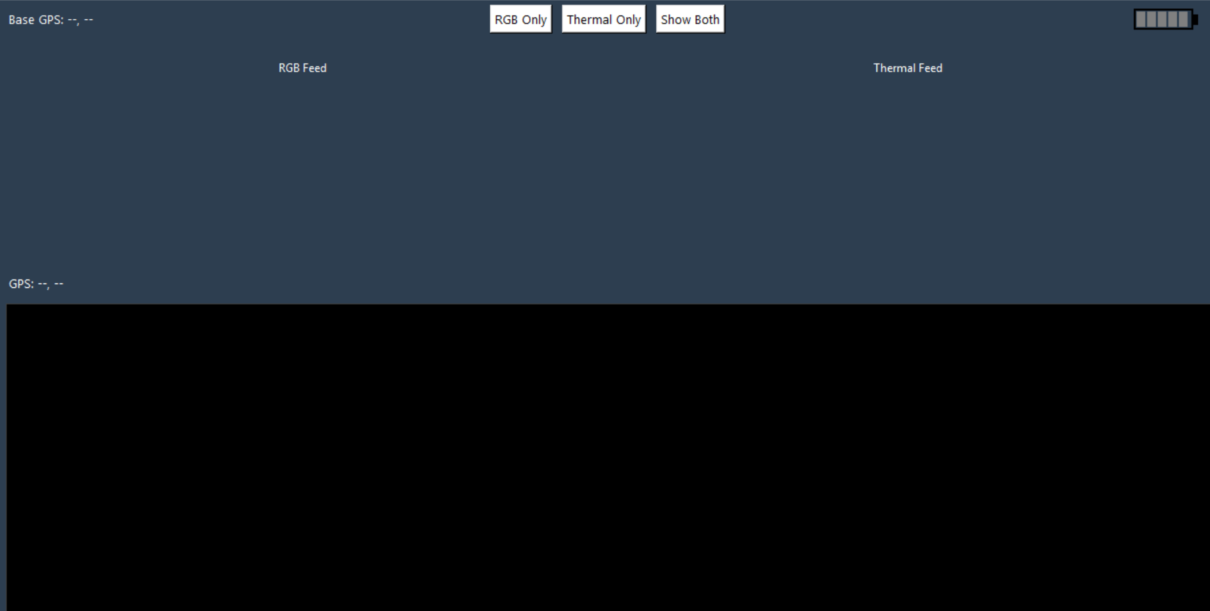
Sparrow GUI overview
Live image feed (RGB & Thermal)
GPS coordinate tracking (Drone & Base)
Fullscreen support for touchscreen
Dynamic layout switching (RGB only, Thermal only, Both)
MAVLink-based image transmission
Custom battery level indicator
Notes:
The Sparrow GUI system acts as the command center for our drone operations.
On the left, you can see the interface. The GUI displays a live image feed from the drones — both RGB and thermal — which helps our team visualize what the drones are detecting.
We also integrated GPS tracking to show the positions of both the drone and the base station. This is key for coordination during a mission.
The GUI supports full-screen mode and is optimized for touchscreen use, making it flexible for field deployment.
Users can toggle the display layout between RGB only, thermal only, or both views at once depending on the situation.
All image data is transmitted using MAVLink, which we chose for its lightweight and reliable communication.
Lastly, we added a custom battery level indicator so operators can monitor power levels during flight.”

Slide 39
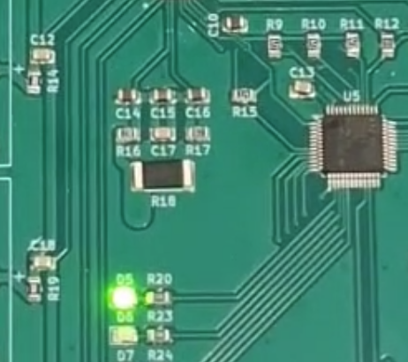
STM32 Testing
To start our testing, we programmed the STM32 to blink an LED to ensure proper functionality.
Notes:
To begin our testing process, we first programmed the STM32 microcontroller to blink an LED as a simple yet effective way to verify that the chip was functioning correctly. This basic test confirmed that the microcontroller was receiving power, the development environment was properly set up, and communication between the STM32 and our programming tools was successful. It also served as a foundational step before moving on to more complex tasks.

Slide 40

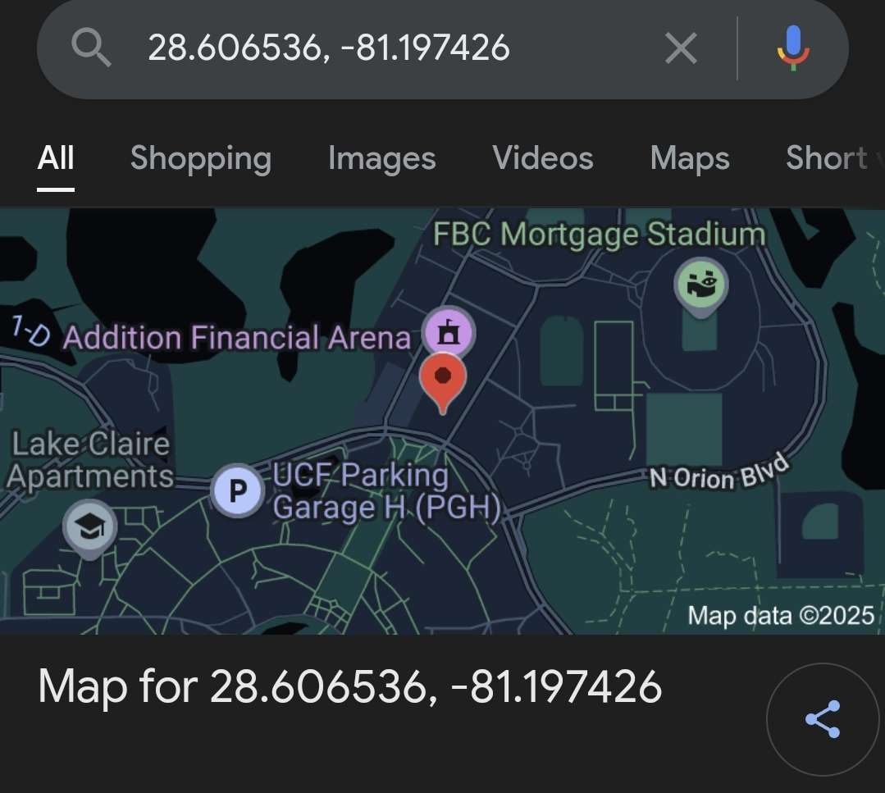
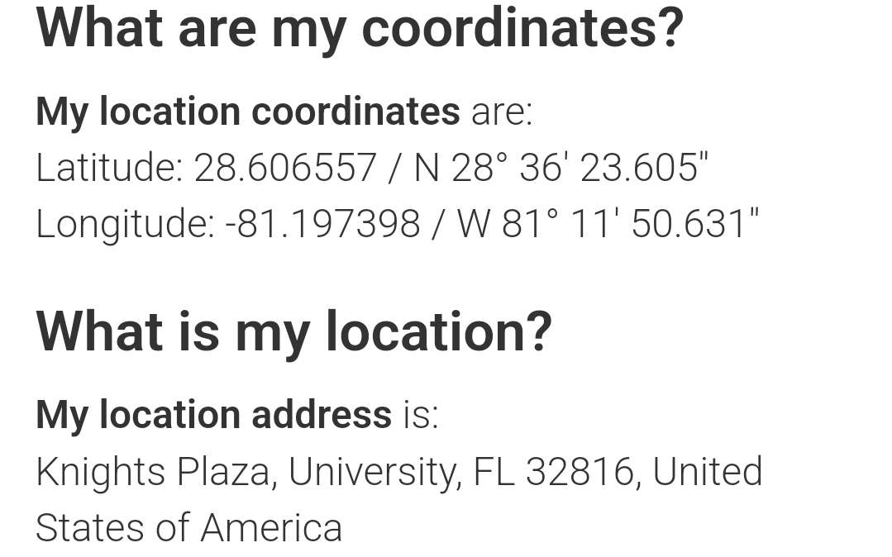
GPS Testing
Notes:
To test our GPS, we went outside of Addition Financial Arena to verify that we were able to receive coordinates. It the top left, you can see the coordinates we received. Once we received these coordinates, we compared them to our known location, as seen in the bottom left. Since one meter is approximately equal to 0.00001 degrees in both latitude and longitude, our results are only off by about 2 meters in each direction. To further verify it’s functionality, we then input our measured coordinates into Google Maps, as seen on the right.

Slide 41
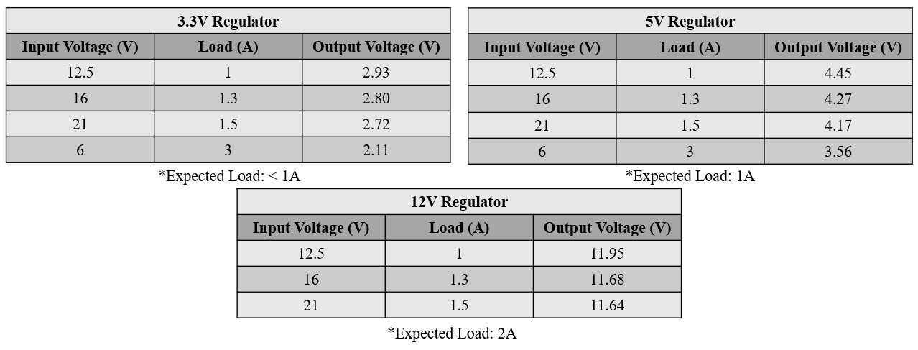
Regulator Testing
Notes:
We tested each regulator at various input voltages and output loads to verify their performance and reliability. The 3.3V regulator, expected to support loads below 1A, showed slightly lower output voltages under heavier loads. However, under typical expected conditions, it maintains a fairly stable output near 2.93V. The 5V regulator, designed to supply around 1A, delivered consistent performance across a range of input voltages and increasing loads, maintaining an output close to 5V. The 12V regulator, which is intended to handle up to 2A, remained the most stable, with output voltages staying very close to the target — from 11.95V down to 11.64V as the load increased. Overall, each regulator demonstrates it can deliver sufficient and reliable power for its target load range under various operating conditions.

Slide 42
BMS Testing
Time | Fault Flags | Measured Battery Level | Actual Battery Level
0:00 | None | 84% | ~88%
0:05 | None | 84% | ~87%
0:10 | None | 84% | ~86%
0:15 | None | 80% | ~84%
0:20 | None | 80% | ~83%
0:25 | None | 80% | ~83%
0:30 | None | 78% | ~82%
Notes:
We powered all system peripherals using the battery array for a continuous 30-minute period to evaluate the accuracy of the BMS's battery charge level readings. During this time, we periodically compared the BMS-reported charge levels with actual voltage measurements taken using a multimeter. The purpose of this test was to assess the reliability of the BMS in real-time operation, particularly under typical system load conditions. The results showed consistency between the BMS readings and actual values, with discrepancies never exceeding 4%, indicating that the BMS provides sufficiently accurate monitoring for our application.

Slide 43
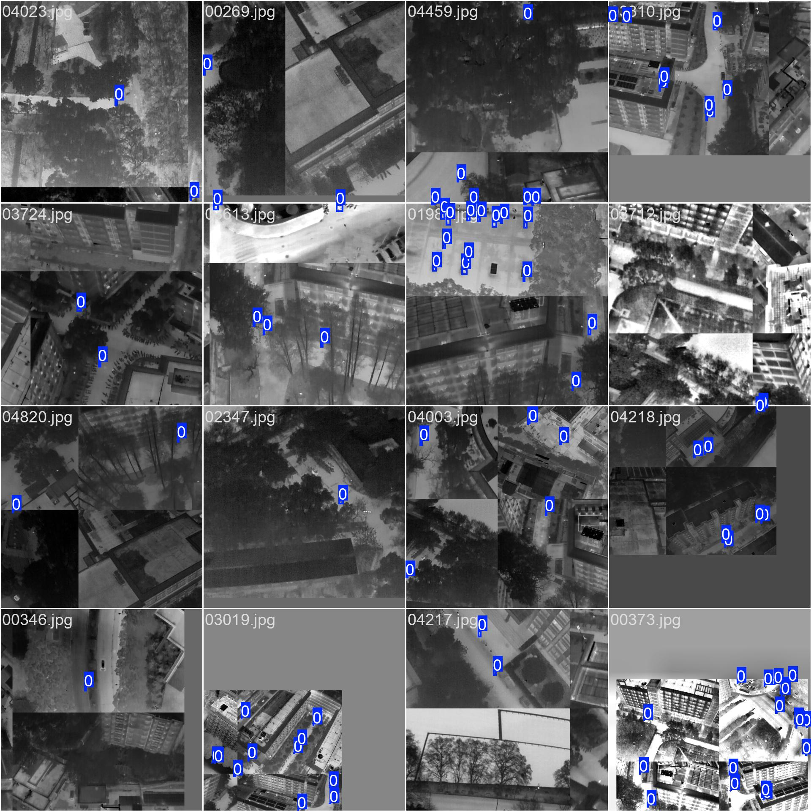
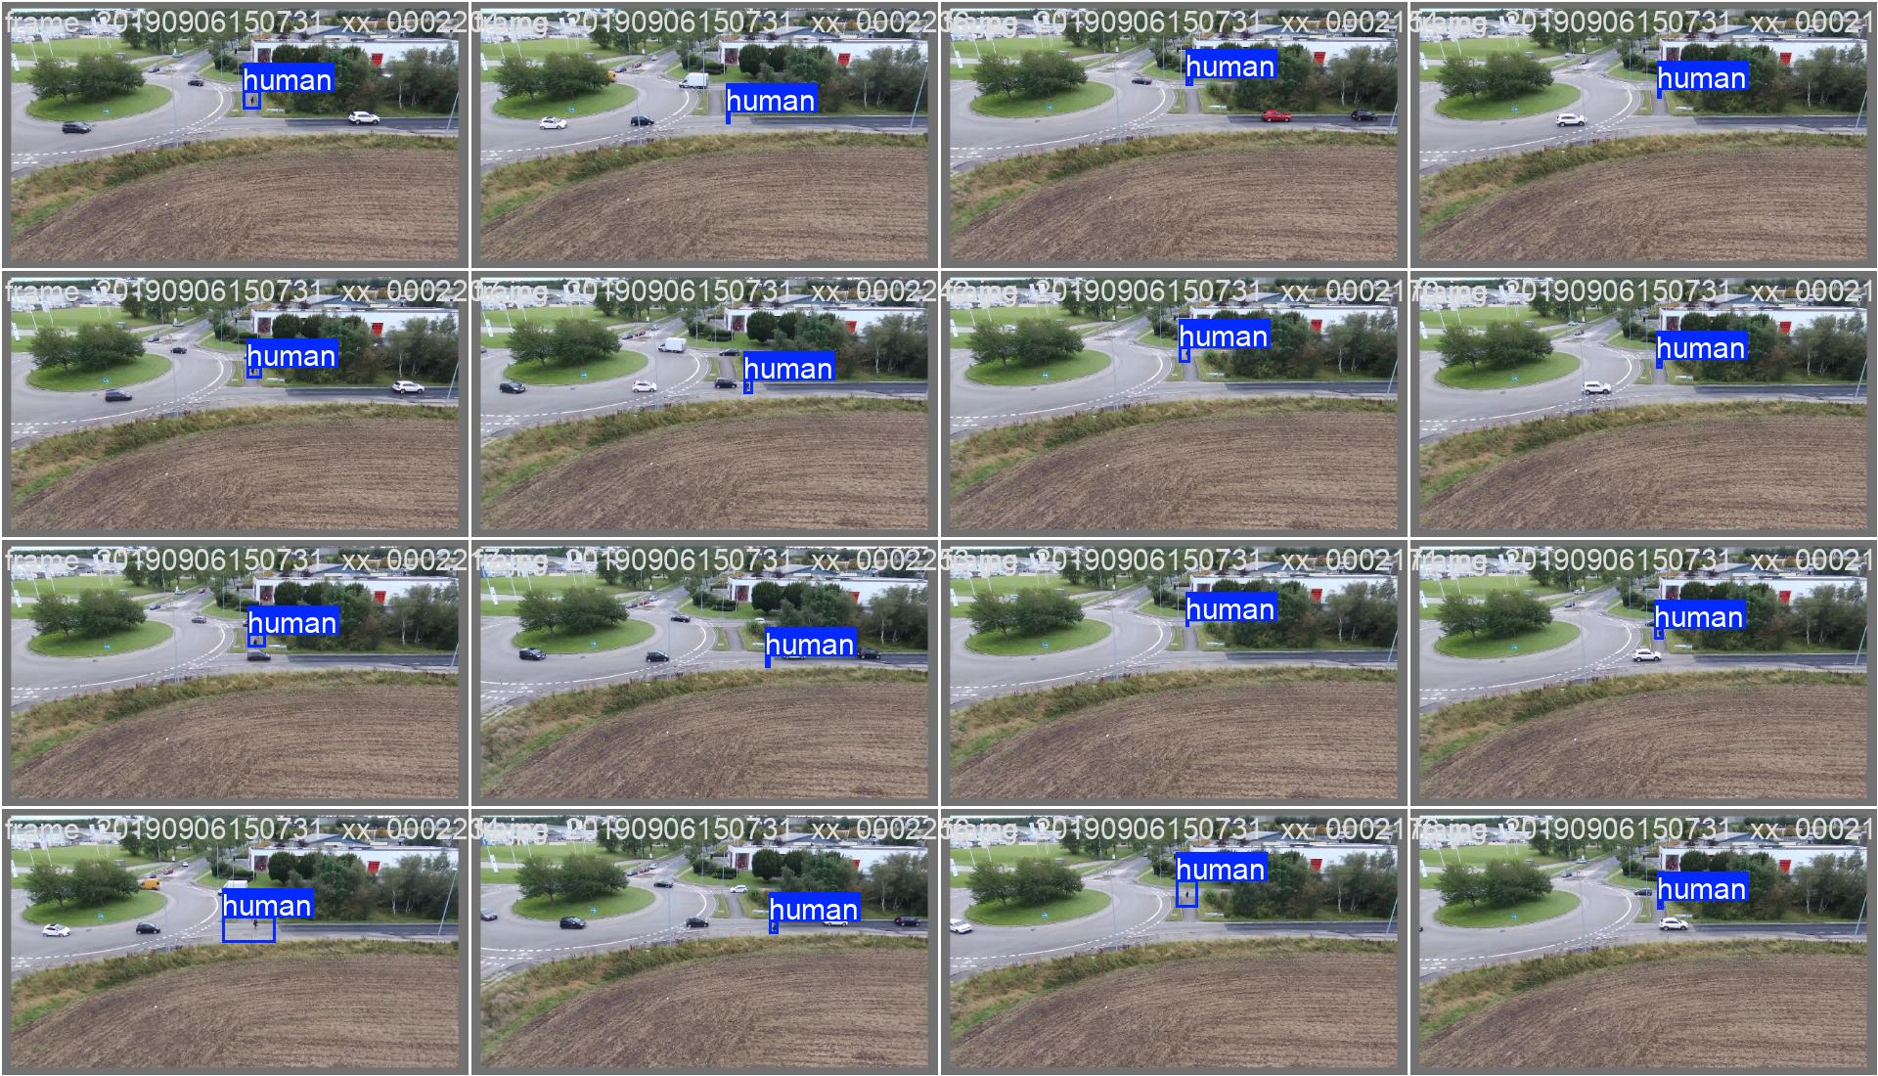
Computer Vision
Used thermal and RGB datasets taken from real drone footage
Model learned to detect people with over 58% average precision
Helps identify people from above in real-time for rescue ops
Notes:
This slide highlights the core of the computer vision system developed for Sparrow.
On the left, you see thermal images, and on the right, RGB footage. These datasets were used to train our AI model to recognize humans from an aerial perspective.
After training on thousands of annotated images, the model reached an average precision of over 58%, which is a solid start given the challenging angles and low resolution of aerial data.
The goal here is for live-image detection. In an actual rescue scenario, this system helps locate people on the ground by analyzing the video stream from the drone. That means a rescuer doesn’t have to scan every frame — the AI highlights potential people instantly.
This gives our team a major advantage in search and rescue situations, especially in large or hard-to-reach areas.

Slide 44
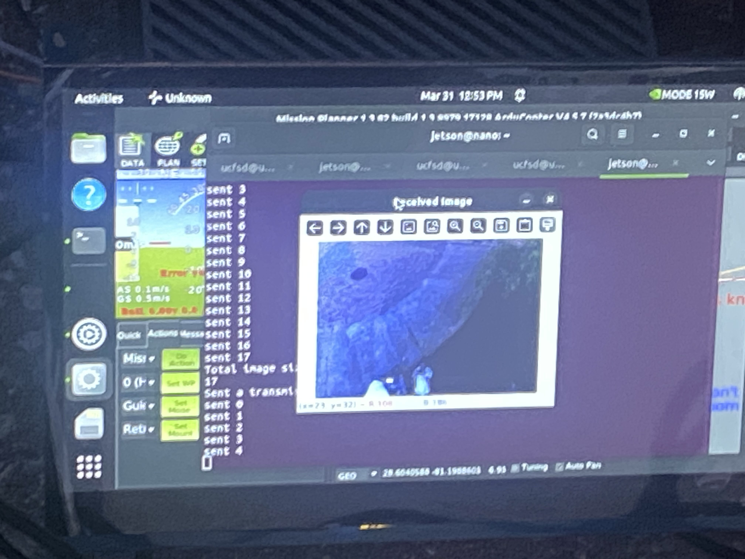
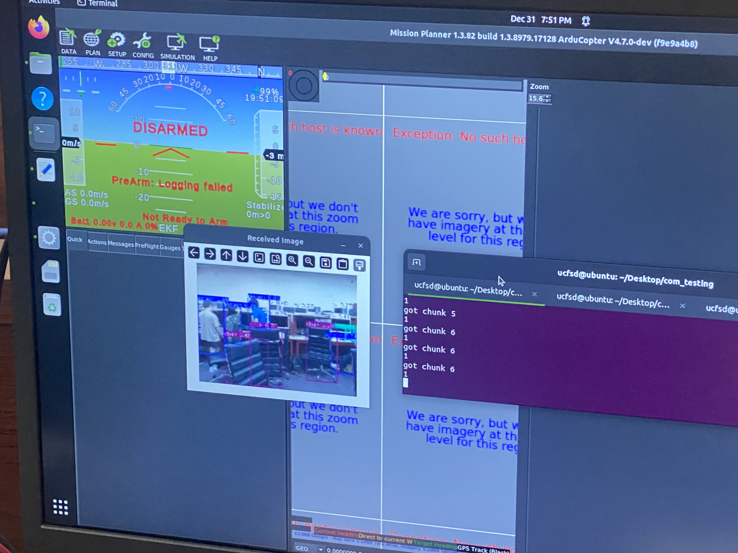
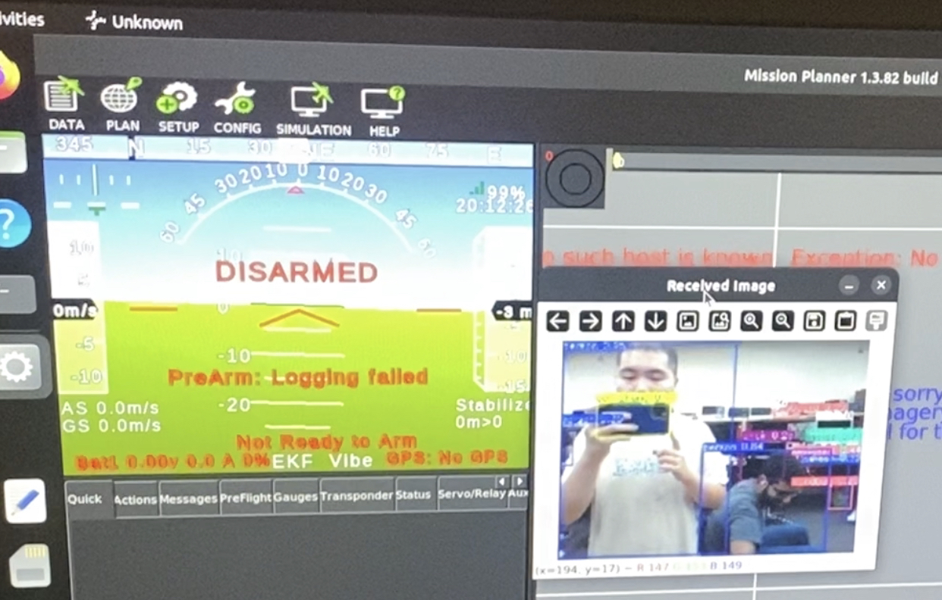
MAVLink and ArduPilot Testing
Using the MAVLink communication testing to showcase image chunks being received and reassembled on the Orin base station.
Signal Strength

Slide 45
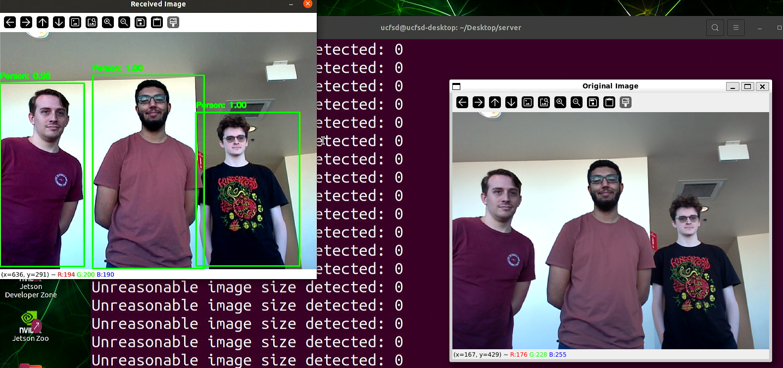
Software Testing
ArduPilot
Wireless Image Transfer
YOLO
Sample Models
Different Environmental Conditions
Notes:
For software testing, we have successfully set up ArduPilot and integrated wireless image transfer between the Jetson Nano and the base controller, ensuring reliable communication with good resolution. We have also tested the Nano’s ability to process and transmit frames efficiently while running YOLO for object detection. We are currently testing different YOLO models to optimize the overall performance of YOLO on the Nano, focusing on achieving the highest possible efficiency in terms of speed and accuracy. These tests help us understand the best configuration for running YOLO in real-time on the Nano. Once we finalize our trained model, we will conduct additional testing under various environmental conditions, including different lighting and weather scenarios, to ensure the system maintains high detection accuracy in any environment

Slide 46
Challenges and Solutions
The Jetson Nano being an outdated product and having very limited RAM, it is not ideal for handling drone data routing alongside human detection and image transmission.
To minimize this problem, the weakest and least resource consuming model was used on the Jetson Nano for human detection in order to conserve resources for other processes.
Data transmission packet loss throughout MAVLink is another challenge as the modems are not that powerful for handling both image data alongside the rapid fire rate of the flight controller data input.
One approach to this was the idea of requesting image packet again during the transmission but unfortunately, this still risk the chance of losing the requesting packet and would stall out the process even more in compared to just sending a new image on the next interval.
To minimize this problem, the streamrates would be limited and image transmission rate would be increased to match in order to match the flight controller’s flood rate.
The L9961 battery management system (BMS) used on the PCB proved to be overly complex for our intended application, offering a range of advanced features that were unnecessary and difficult to implement given the relatively simple monitoring and protection requirements of our system. A more straightforward BMS solution would have reduced integration time.

Slide 47
Improvements and Takeaways
For this project in general, the Jetson hardware devices were not good as the Jetson Nano had many problems to be running as a companion computer on the drones. It would have been better to use anything besides this product as it is obsolete.
The communication setup for relaying between drones is not advisable as the radio modems are not meant for relaying mesh networks since they only come with peer to peer firmware or multi-nodal broadcasting network. Even though the modems are considered the best for the MAVLink protocol by the creators of MAVLink, it is not designed for relaying mesh network protocol.
It would have been better to attach the cameras onto the flight controller for image transmission rather than trying to flood the stream on routing with the Jetson Nano.
Notes:
This project could have many improvements throughout the design. To begin, the Jetson hardware devices had many flaws coming into this project, especially the Jetson Nano as they were not meant for companion computers due to the lack of resources. The next thing was that the radio modems were not meant for relaying mesh networks as they came only with peer to peer firmware or broadcasting network despite the fact that the modems are considered the best by the MAVLink developers. The modems are also susceptible to environment interference when testing around the area, hence it is not as far as it was specified. Lastly, flooding the Jetson Nano’s MAVLink router with both flight controller data alongside image data made it worse in terms image transmission proficiency and would have been better if a flight controller did the job instead and have human detection at the base.

Slide 48
Bill of Materials
LiDAR | RPLIDAR C1 | $209.97
Thermal Camera Provided by Lockheed Martin | Boson Longwave Infrared (LWIR) OEM Module 320 | $0.00
Camera | ELP-SUSB1080P01-LC1100 | $68.99
PCBs | First Revs | $122.54
 | Second Rev | $129.03
Parts | First Rev | $145.74
 | Second Rev | $186.38
Display | HMTECH 7-inch Raspberry Pi Screen | $38.33
Radio Modem | RFD900x-US Bundle | $226.00
STLink | ST-Link STM8/STM32 v2 Compatible Programmer & Emulator | $0.00
Processor Provided by Lockheed Martin | Jetson AGX Orin Developer Kit | $0.00
Battery | LG INR21700-M50 | $25.85
Total |  | $1,152.83

Slide 49
Work Distribution
Jack Communication Setup Embedded Software Website Management Administrative Documentation | Max PSU Design PCB Design Hardware Implementation Embedded Software | Isaiah Communication Setup Hardware Implementation PCB Design Embedded Software
Patrick Computer Vision Communication Setup GUI | Esteban Computer Vision Software Implementation GUI
Primary | Secondary

Slide 50
Thanks!
Notes:
Thank you for watching, this has been group Sparrow

